Slide 1
Software Development Life Cycle (SDLC) Models

Slide 2
Software Engineering
The goal of Software Engineering is to provide models and processes that lead to the production of well-documented maintainable software
Software engineering is defined as the systematic approach for development of (industrial strength) software

Slide 3
Software Process
Process: A sequence of steps performed to achieve some goal
Software Process: The sequence of steps performed to produce software with high quality, within budget and schedule
Many types of activities performed by diff people in a software project
Better to view software process as comprising of many component processes

Slide 4
Components of Software Process
Two major processes
Development – focuses on development and quality steps needed to engineer the software
Project management – focuses on planning and controlling the development process
Development process is the heart of software process; other processes revolve around it
These are executed by different people
developers execute engineering process
project managers execute management process

Slide 5
Process Specification
Process is generally a set of phases
Why have phases
To employ divide and conquer
each phase handles a different part of the problem
helps in continuous validation
Each phase performs a well defined task and generally produces an output
Intermediate outputs – work products
At top level, typically few phases in a process
Methodologies (How to execute) of particular phases may be well defined

Slide 6
ETVX Specification
ETVX approach to specify a step
Entry criteria: what conditions must be satisfied for initiating this phase
Task: what is to be done in this phase
Verification: the checks done on the outputs of this phase
eXit criteria: when can this phase be considered done successfully
A phase also produces information for management

Slide 7
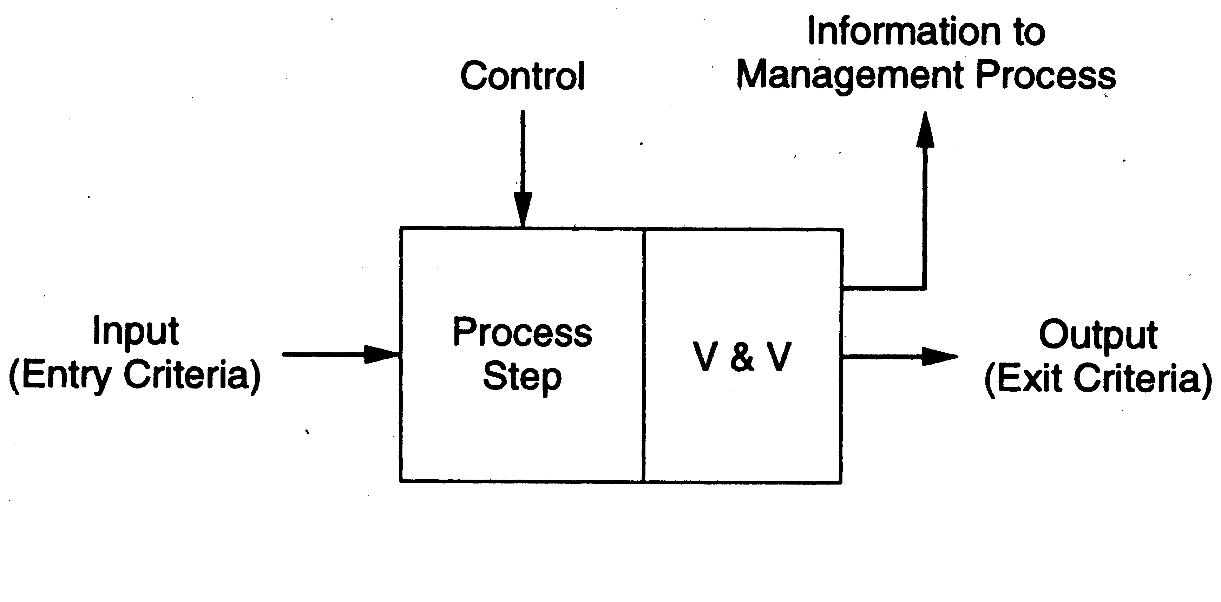
ETVX approach

Slide 8
General S/W Development Process
Software development process commonly has these activities:
Requirements analysis
Design
Coding
Testing
Delivery
Different models perform them in different manner

Slide 9
Waterfall Model
Linear sequence of stages/phases
Requirements – Design– Code – Test – Deploy
A phase starts only when the previous has completed; no feedback
The phases partition the project, each addressing a separate concern
Each phase has output in the form of specific documents

Slide 10
Waterfall Model
Requirement Analysis
Software Requirement Specification (SRS) Document
Design
Design Documents
Implementation
Programs
Testing
Test Plans and Test Reports
Deployment & Maintenance
User Manuals/ Supporting Docs
Fig: Sequence of steps in Waterfall model

Slide 11
Waterfall Model
This model is easy to understand and reinforces the notion of “define before design” and “design before code”
The model expects complete & accurate requirements early in the process

Slide 12
Waterfall Advantages
Conceptually simple, cleanly divides the problem into distinct phases that can be performed independently
Natural approach for problem solving
Easy to administer – each phase is a milestone

Slide 13
Waterfall disadvantages
Assumes that requirements can be specified and frozen early which is unrealistic
not suitable for accommodating any change
May fix hardware and other technologies too early
Follows the “big bang” approach – all or nothing delivery; too risky
Very document oriented, requiring docs at the end of each phase
Real projects are rarely sequential.

Slide 14
Prototyping
Prototyping addresses the requirement specification limitation of waterfall
Instead of freezing requirements only by discussions, a prototype is built to understand the requirements
Helps alleviate the incorrect requirements risk
A small waterfall model replaces the requirements stage

Slide 15
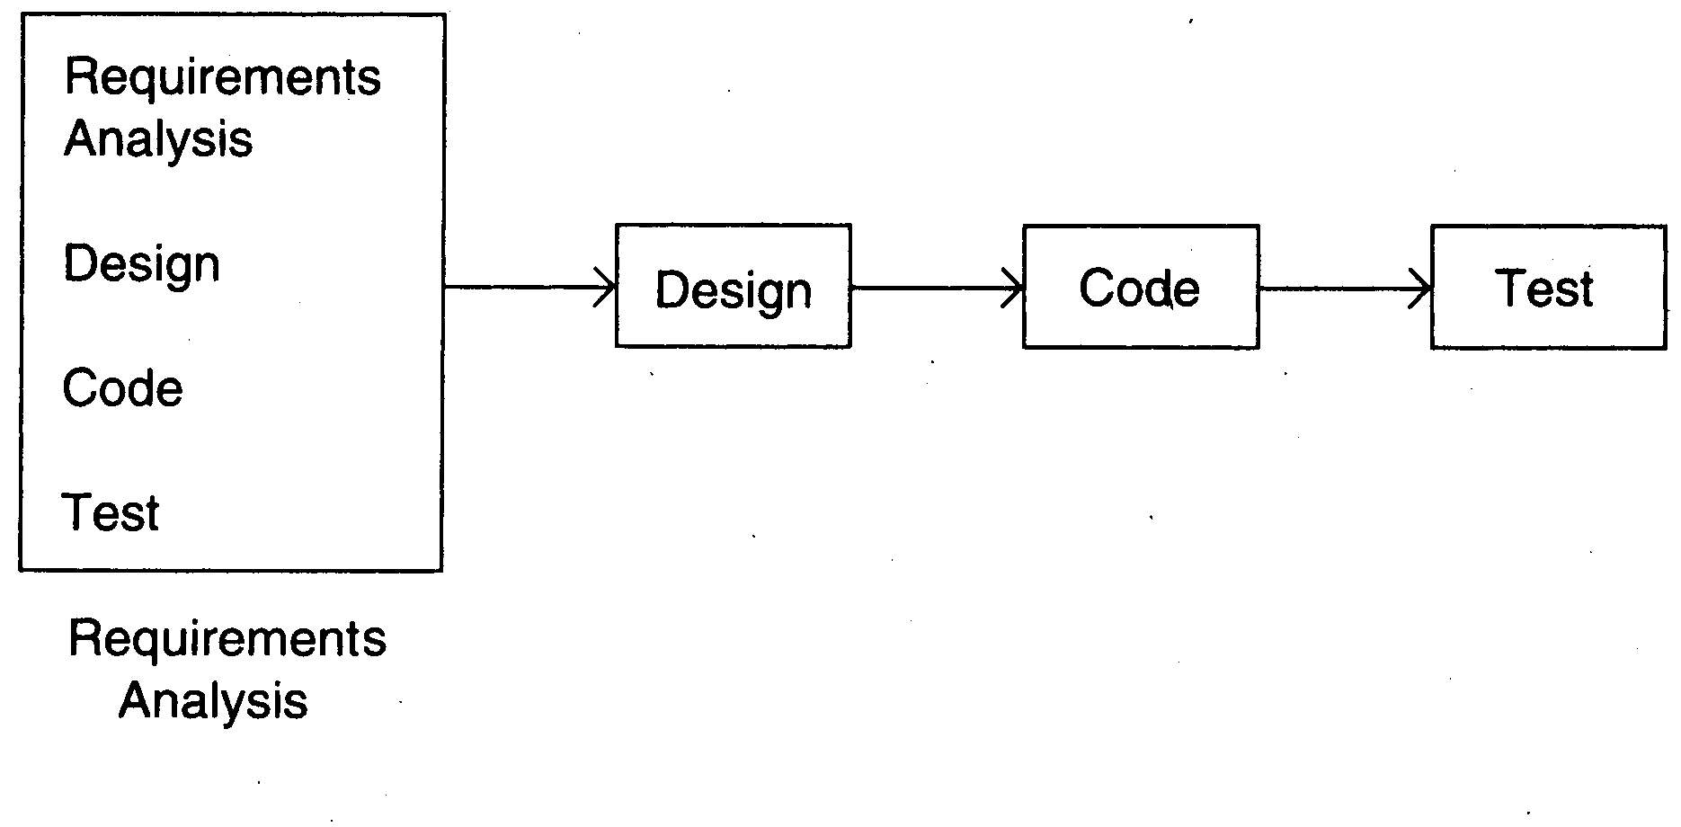
Prototyping

Slide 16
Prototyping
Development of prototype
Starts with initial requirements
Only features which are unclear are included in prototype
Feedback from users taken to improve the understanding of the requirements
The code for the prototype is generally thrown away. However experience gathered helps in developing the actual system.

Slide 17
Prototyping
The development of a prototype might involve extra cost, but overall cost might turnout to be lower than that of an equivalent system developed using the waterfall model.
“quick and dirty” – quality not important
Things like exception handling, recovery, standards are omitted
Learning in prototype building will help in building the software, besides improved requirements

Slide 18
Prototyping
Advantages
Allows flexible and unclear requirement, requirements frozen later
Experience helps in the main development
Disadvantages
Potential hit on cost and schedule
Applicability:
When requirements are hard to elicit and confidence in requirements is low; i.e. where requirements are not well understood

Slide 19
Iterative Development
Counters the “all or nothing” drawback of the waterfall model
Combines benefit of prototyping and waterfall
Develop and deliver software in increments
Each increment is complete in itself
Can be viewed as a sequence of waterfalls
Feedback from one iteration is used in the future iterations
Newer approaches like XP, rely on iterative development

Slide 20
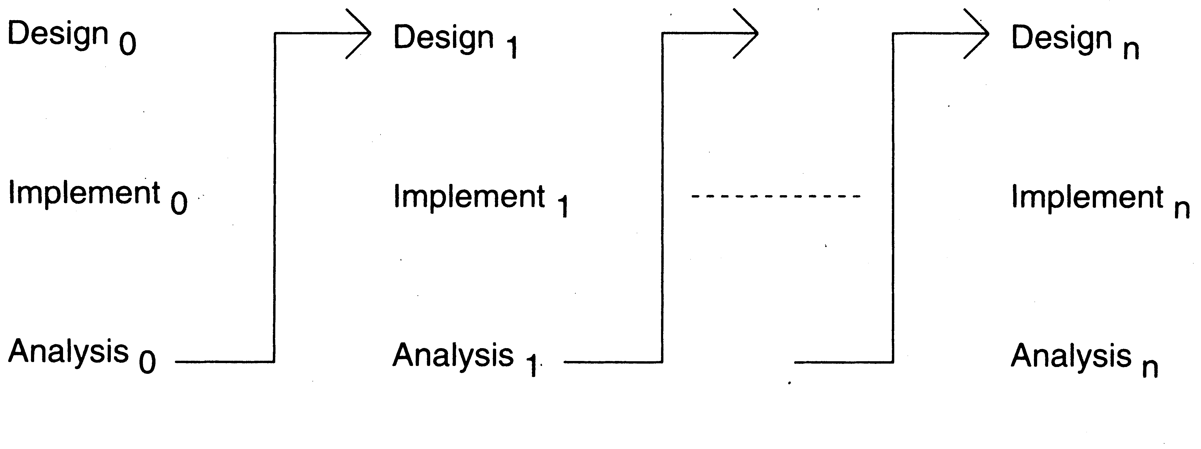
Iterative Enhancement

Slide 21
Iterative Development
Benefits
Get-as-you-pay
feedback for improvement
Drawbacks
Architecture/design may not be optimal
rework may increase
total cost may be more
Applicability
where response time is important, risk of long projects cannot be taken, all requirements not known

Slide 22
Another Form of Iterative
The first iteration does the requirements and architecture (Design) in the waterfall way
The development and delivery is done incrementally in iterations

Slide 23
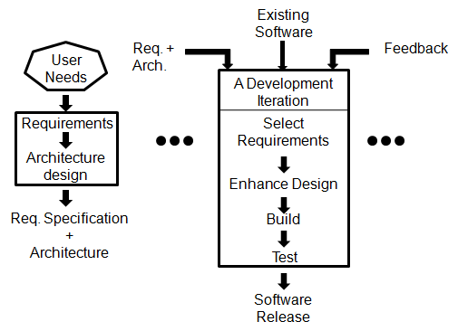
Another form of Iteration…

Slide 24
Timeboxing
Iterative is linear sequence of iterations
Each iteration is a mini waterfall – decide the specifications, then plan the iteration
Time boxing – fix an iteration’s duration, then determine the specifications
Pipelined Iterations
Divide iteration in a few equal stages
Use pipelining concepts to execute iterations in parallel

Slide 25
Timeboxing – Taking Time Boxed Iterations Further
Multiple iterations executing in parallel
Can reduce the average completion time by exploiting parallelism
For parallel execution, can borrow pipelining concepts from hardware
This leads to Timeboxing Process Model

Slide 26
Timeboxing Model – Basics
Development is done iteratively in fixed duration time boxes
Each time box is divided in fixed stages
Each stage performs a clearly defined task that can be done independently
Each stage is approximately equal in duration
There is a dedicated team for each stage
When one stage team finishes, it hands over the project to the next team

Slide 27
Timeboxing
With this type of time boxes, can use pipelining to reduce cycle time
Like hardware pipelining – view each iteration as an instruction
As stages have dedicated teams, simultaneous execution of different iterations is possible

Slide 28
Example
An iteration with three stages – Analysis, Build, Deploy
These stages are appx equal in many situations
Can adjust durations by determining the boudaries suitably
Can adjust duration by adjusting the team size for each stage
Have separate teams for A, B, and D

Slide 29
Pipelined Execution
AT starts executing it-1
AT finishes, hands over it-1 to BT, starts executing it-2
AT finishes it-2, hands over to BT; BT finishes it-1, hands over to DT; AT starts it-3, BT starts it-2 (and DT, it-1)
…

Slide 30
Timeboxing Execution

Slide 31
Timeboxing execution
First iteration finishes at time T
Second finishes at T+T/3; third at T+2 T/3, and so on
In steady state, delivery every T/3 time
If T is 3 weeks, first delivery after 3 wks, 2nd after 4 wks, 3rd after 5 wks,…
In linear execution, delivery times will be 3 wks, 6 wks, 9 wks,…

Slide 32
Timeboxing execution
Duration of each iteration still the same
Total work done in a time box is also the same
Productivity of a time box is same
Yet, average cycle time or delivery time has reduced to a third

Slide 33
Team Size
In linear execution of iterations, the same team performs all stages
If each stage has a team of S, in linear execution the team size is S
In pipelined execution, the team size is three times (one for each stage)
I.e. the total team size in timeboxing is larger; and this reduces cycle time

Slide 34
Team Size
Merely by increasing the team size we cannot reduce cycle time - Brook’s law
Timeboxing allows structured way to add manpower to reduce cycle time
Note that we cannot change the time of an iteration – Brook’s law still holds
Work allocation different to allow larger team to function properly

Slide 35
Work Allocation of Teams

Slide 36
Timeboxing
Advantages
Shortened delivery times
other advantages of iterative
distributed execution
Disadvantages
Larger teams, project management is harder
high synchronization needed
Applicability
When delivery time is short
architecture is stable; flexibility in feature grouping

Slide 37
Agile Process Model
Agile approaches developed in 90s as a reaction to document driven approaches
Most agile approaches have some common principles
Working software is the measure of progress
Software should be delivered in small increments
Even late changes should be allowed
Prefer face to face communication over documentation
Continuous feedback and customer involvement is necessary
Prefer simple design

Slide 38
Extreme Programming (XP)
Many agile methodologies have been proposed; extreme programming (XP) is one of the most popular
Other agile methodologies are Scrum, Lean, Kanban, Crystal, Dynamic Systems Development Method (DSDM), Feature-Driven Development (FDD)
An XP project starts with user stories, which are short descriptions of user needs
Details are not included
User stories can be combined in different ways

Slide 39
Overall Process
Team estimates how long it will take to implement a user story
Estimates are rough
Release planning is done
Defines which stories are to be built in which release, and dates for release
Frequent and small releases encouraged
Acceptance tests also built from user stories; used to test before release
Bugs found in AT are fixed in next release

Slide 40
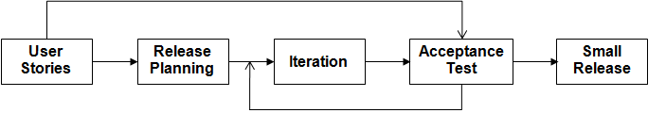
XP – Overall Process

Slide 41
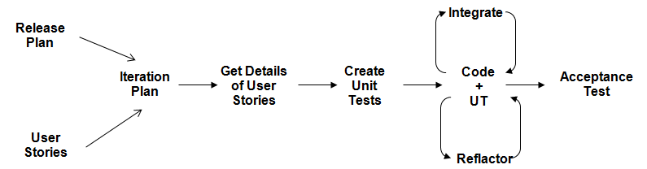
An Iteration

Slide 42
XP - Summary
Well suited for situations where volume and pace of requirements is high
Customer is willing to engage heavily with the team
The team is collocated and is not too large (less than 20 or so)
Requires strong capability in team members

Slide 43
Summary – waterfall
Strength | Weakness | Types of Projects
Simple Easy to execute Intuitive and logical | All or nothing – too risky Req frozen early Disallows changes No feedback from users | Well understood problems, automation of existing manual systems

Slide 44
Summary – Prototyping
Strength | Weakness | Types of Projects
Helps req clarification Reduces risk Better and more stable final system | Possibly higher cost and schedule Encourages requirement modification Disallows later change | Systems with novice users; or areas with req uncertainity.

Slide 45
Summary – Iterative
Strength | Weakness | Types of Projects
Regular deliveries, leading to business benefit Can accommodate changes naturally Allows user feedback Avoids req bloating Naturally prioritizes req Reduces risks | Overhead of planning each iteration Total cost may increase System arch and design may suffer Rework may increase | For businesses where time is imp; risk of long projects cannot be taken;

Slide 46
Summary – Timeboxing
Strength | Weakness | Types of Projects
All benefits of iterative Planning for iterations somewhat easier Very short delivery times | Project Management becomes more complex Team size is larger Complicated – lapses can lead to losses | Where very short delivery times are very important Projects which can afford high costing (Multiple teams)

Slide 47
Summary – XP
Strength | Weakness | Types of Projects
Agile and responsive Short delivery cycles Continuous feedback can lead to better acceptance Reduced documentation | Can tend to become ad-hoc Lack of documentation can be an issue Continuous code change is risky | Where requirements are changing a lot, customer is deeply engaged in development, and where the size of the project is not too large

Slide 48
Rapid Application Development (RAD) Model
Prototype based SDLC model
Encouragement of code reuse, which means less manual coding, less room for errors, and shorter testing times
High level of client engagement like other agile techniques

Slide 49
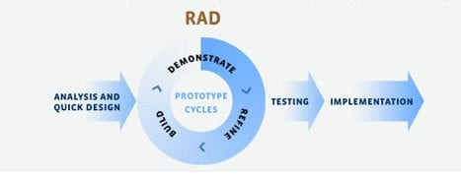
Rapid Application Development (RAD) Model
Steps of RAD
Requirements (Flexible) Analysis
Design
Build a prototyope (Demonstrate to user and keep refining it as per user satisfaction)
Testing
Deployment

